Slide 1

ESSA
Title I Part A – Improving Basic Programs
Title II Part A – Supporting Effective Instruction
Title IV Part A – Student Support and Academic Enrichment Meaningful Consultation
Griselda Alvarez
Federal and SCE Programs Director
May 9, 2024

Slide 2
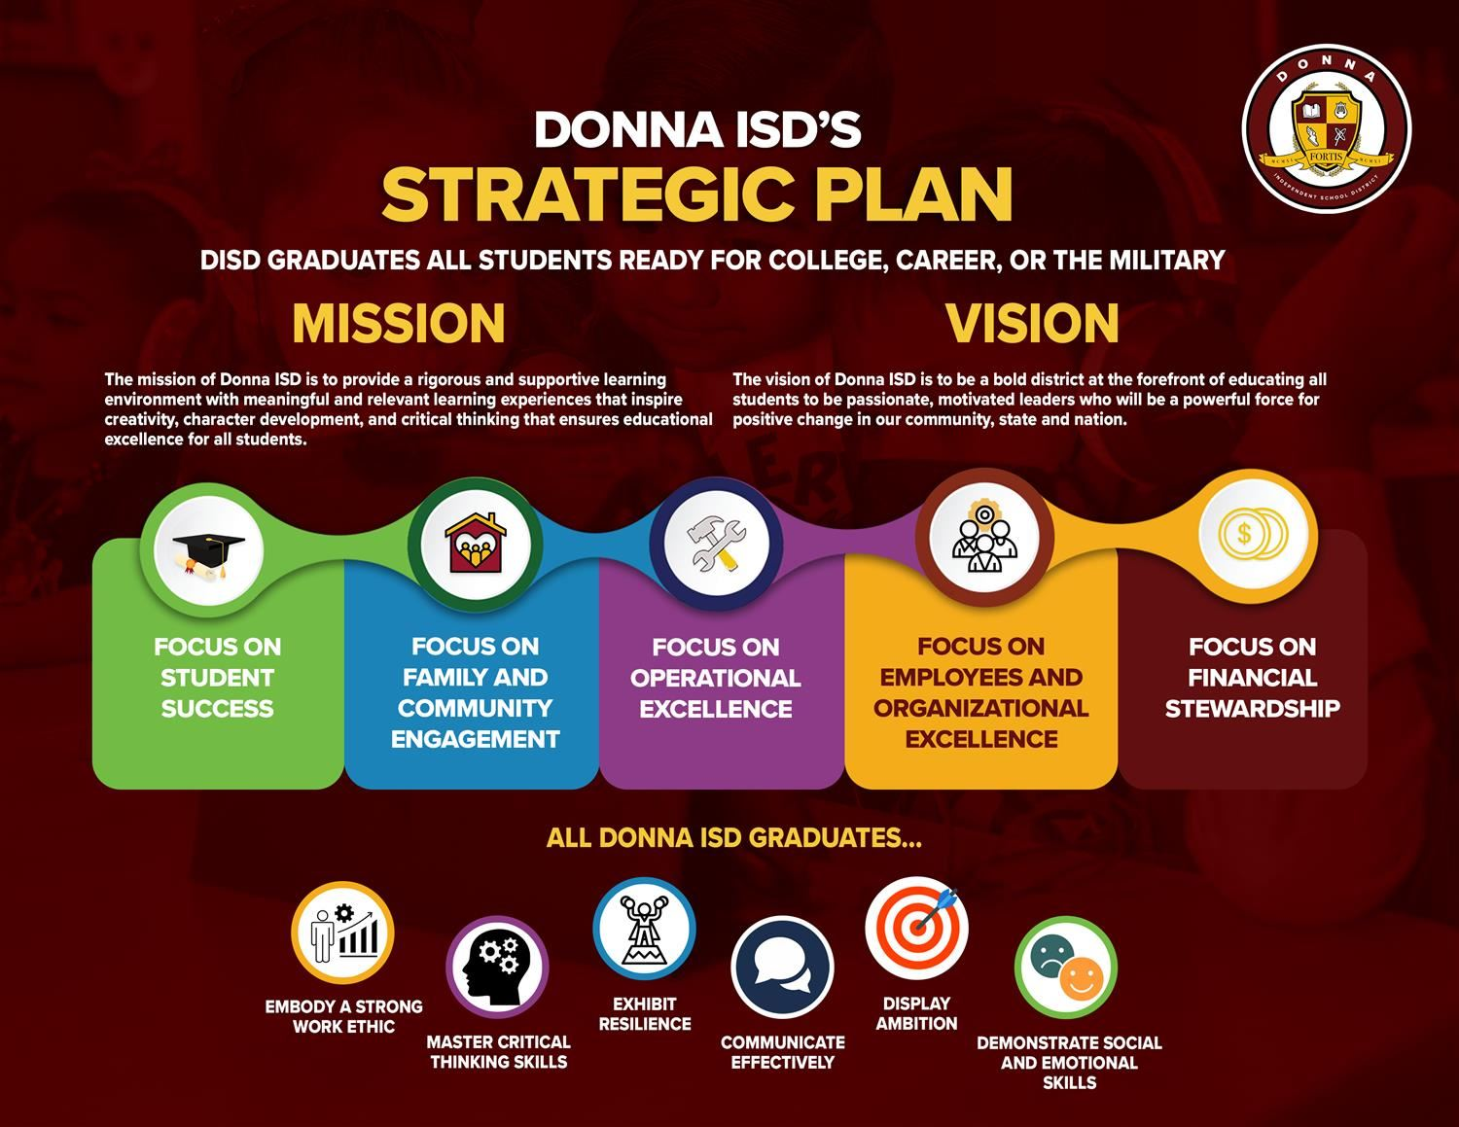

Slide 3
ESSA Committee
Name | Campus | Role/Area
Lee De Hoyos |  | Parent
Timo De Leon |  | Parent
Michael Guerrero |  | Parent
Monica Gonzalez |  | Parent
Elizabeth Ojeda |  | Parent
Karla Y. Uvalle | Donna High School | Dean
Leo De Leon | W.A. Todd Middle School | Student
Jairo Gonzalez | A.P. Solis Middle School | Student
Renee De Hoyos | Donna High School | Student
Elias Guerrero | Donna High School | Student
Frank De Hoyos | C. Stainke Elementary | PE Coach
Maria De Leon | B.G. Guzman Elementary | Teacher
Isela Cantu | M.A.P. Munoz Elementary | Teacher
Brenda Santana | Donna High School | Teacher
Angelica Guerrero | C. Stainke Elementary | Teacher
Brianna Alvarez | Donna North High School | Teacher
Emma Pagan-Sayavedra | Caceres Elementary | Teacher
Ricardo Moreno | LeNoir Elementary | Music Teacher
Anna Michelle Partida | Donna North High School | Health Science Teacher
Leslie Cardoza | C. Stainke Elementary | Instructional Aide
Sara Zamora | C. Stainke Elementary | Instructional Aide
Gilbert Guerrero |  | Community
Sandy Solis |  | Community
Erika Lopez |  | Community
Name | Campus | Role/Area
Griselda Alvarez | Central Office | Federal Programs Director
Nelida Alvarado | Central Office | Federal Programs Coordinator
Ana De Hoyos | Central Office | Accountant
Desiree Cano | C&I | Fine Arts Strategist
Rigoberto Rivera | Athletics | PE Strategist
Debra Harris | Central Office | Coordinator for CCMR
San Juanita Franco | Central Office | Advanced Academics Director
Emily Anderson | C&I | Science Director
Sylvia Vela | C&I | Director for English Language Arts
Allison Ortega | C&I | Social Studies Director
Gregorio Arellano | C&I | Bilingual Director
Dr. Ruben Castro | Central Office | Director for Grant Writing
David Mosqueda | Central Office | Director for Benefits/Safety & Risk
Ofelia Alvarez | Learning & Dev. Center | Director for Testing/Evaluation
Dr. Melanie Ballardo | Central Office | SEL Supervisor
Nelda Calderon | W.A. Todd Middle School | Principal
Janie Alaniz | E. Salazar Elementary | Principal
Mary Lou Rodriguez | A.P. Solis Middle School | Principal
Alfonso Sayavedra | A.M. Ochoa Elementary | Principal
Karen Nieto | J.P. LeNoir Elementary | Principal
Maria Hinojosa | Capt. D. Salinas II Elementary | Principal
Leslie Castro | Donna North High School | Assistant Principal
Elsa Guzman | M.A.P. Munoz Elementary | Assistant Principal
Lee De Hoyos |  | Parent
Timo De Leon |  | Parent
Michael Guerrero |  | Parent
Monica Gonzalez |  | Parent
Elizabeth Ojeda |  | Parent

Slide 4
Title I Part A Intent and Purpose
Title I, Part A program goals are to ensure that all children have a fair, equal, and significant opportunity to obtain a high-quality education and reach, at a minimum, proficiency on challenging state academic standards and state academic assessments.
Title I, Part A provides supplemental resources to help schools with high concentrations of students from low-income families acquire the knowledge and skills in the state content standards and to meet the state student performance standards.
Title I, Part A provides support to schools in implementing either a school-wide program or a targeted assistance program and requires that these programs use effective methods and instructional strategies that are grounded in scientifically based research.
The purpose of Title I Part A is to provide all children significant opportunity to receive a fair, equitable, and high-quality education, and to close educational achievement gaps between children meeting the challenging State academic standards and those children who are not meeting such standards.

Slide 5
General Campus Allocation Rules
An LEA that has a total enrollment of fewer than 1,000 students may allocate funds to any campus, regardless of rank order of poverty.
An LEA that has a total enrollment of 1,000 students or more must allocate funds to campuses in rank order based on the total number of low-income students in each attendance area.
The LEA is not required to allocate the same per-child amount to each campus; however, the LEA must not allocate a greater per-child amount to a campus with a lower poverty rate than it allocates to campuses with higher poverty rates.
An LEA that chooses to serve campuses with 75 percent poverty or less using grade span groupings may determine different per-child amounts for different grade spans if those amounts do not exceed the amount allocated to any campus above 75 percent poverty. Per-child amounts within grade spans may also vary, as long as the LEA allocates higher per-child amounts to campuses with higher poverty rates than it allocates to campuses in the grade span with lower poverty rates.

Slide 6
Allowable Costs
Supplies/materials and equipment that will help the all students meet state academic standards.
Tutorials-Core Content Area.
Family Engagement services to help parent help their child at home. Provide assistance to parents of children served by the school or LEA, as appropriate, in understanding such topics as the challenging State academic standards, State and local academic assessments, the requirements of Title I, Part A, and how to monitor a child’s progress and work with educators to improve the achievement of their children.
Professional Development for teachers in the Core Content Areas.
Educational Field Trips.
Supplemental personnel such as Instructional Officer, Dean of Instruction and Strategist.
Online instructional services.
Small equipment for student and teacher use. iPads, Laptops, Eiki Projectors, Apple TVs.
STAAR test workbooks and manipulatives.

Slide 7

Requirements for using Title I Part A Funds
The campus in question must be a Title I, Part A campus.
The LEA must have a valid Supplement Not Supplant methodology for allocating State and local funds, or Statement of Exemption.
The LEA must ensure that activities and/or resources are:
  Identified in the Comprehensive Needs Assessment;
  Included in the Campus Improvement Plan (the plan must address how the activity/resources identified will be evaluated and how the needs of students at risk of no meeting state standards are being met;
  Reasonable;
  Necessary to carry out the intent and purpose of the Title I Part A Program;
  Allocable and allowable under Title I, Part A.
The LEA must ensure that the expenditure(s) meet all EDGAR requirements.
The LEA must ensure that all district policies and procedures are followed.

Slide 8
What is Currently in Place at DISD
2023-2024 Entitlement | 9,625,712
2022-2023 Carryover | 1,370,709
Indirect Cost | (429,238)
Estimated Grand Total | 10,567,183
Salaries | 9,095,410
Federal Programs Dept/Part-Time | 221,511
Summer School Program | 680,736
Black Board Connect | 26,316
Rivas After School Camp | 15,000
Foster Care Transportation | 10,000
Homeless | 10,070
Parental Involvement Dept. | 154,118
Campus Allocations | 354,022
Total Expenditures | 10,567,183

Slide 9
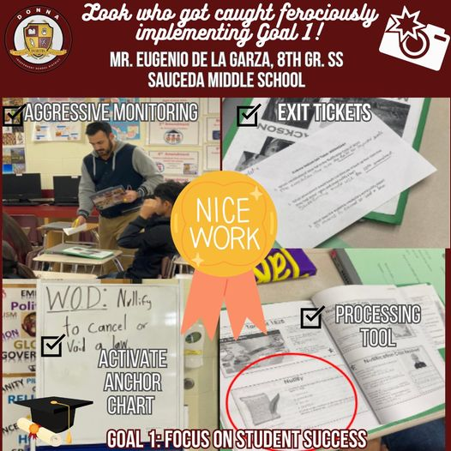
Title II Part A Supporting Effective Instruction

Slide 10

The Purpose of Title II Part A
Increase student achievement consistent with the challenging State academic standards;
Improve the quality and effectiveness of teachers, principals, and other school leaders;
Increase the number of effective teachers, principals, and other school leaders who are effective in improving student academic achievement in schools; and
Provide low-income and minority students greater access to effective teachers, principals, and other school leaders.

Slide 11

Intent
The intent of the funding is to support educators in their work to improve the overall quality of instruction and ensure equity of educational opportunity for all students.

Slide 12
Areas of Focus
Title II, Part A allowable activities included in the ESSA statute and in the Non-Regulatory Guidance from the U.S. Department of Education (issued on September 27, 2016) have been categorized into three areas of focus.
Recruiting, Supporting, and Retaining Effective Teachers and Principals
Professional Development and Educator Growth
Other Evidence-Based Activities

Slide 13
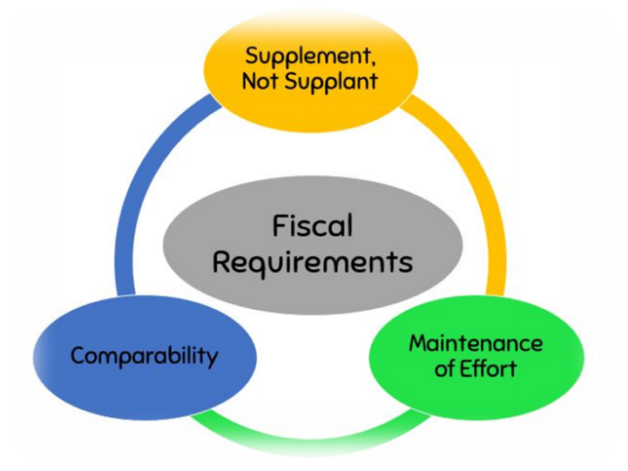
Supplement Not Supplant
“Funds made available under this Title shall be used to supplement, and not supplant, non-Federal Funds that would otherwise be used for activities authorized under this Title.” [ESSA Section 2301]

Slide 14
Recruiting and Retaining Effective Teachers and Principals
Title II, Part A allowable activities in the area of recruiting and retaining effective teachers and principals include activities in the following categories:
Recruiting, Hiring, and Retaining Effective Teachers in High-Need Schools;
Educator Induction and Mentorship Programs;
Teacher Leadership;
School Principal Support;
Educator Cultural Competence;
Recruiting Qualified Individuals from Other Fields; and
Improving School Working Conditions.

Slide 15
Professional Development
Must be:
Sustained
Intensive
Collaborative
Job-Embedded
Data-Driven
Personalized or based on information from an evaluation and support system and
Classroom-focus
RATHER THAN:
Professional development that stands alone
Does not connect to a larger school-wide or individualized plan

Slide 16
Examples of Professional Development
Assessments and Data Analysis
Career Readiness Education
Child Sexual Abuse Prevention
Early Childhood Instruction
Effectively Teaching Children with Disabilities
Effective Teaching English Learners
Evaluation and Support Systems
Evidence-Based Professional Development
Identification and Support of Gifted Students
School Library Programs
Supporting Students Affected by Trauma and/or Mental Illness
STEM-focused Professional Development

Slide 17
What is Currently in Place at DISD
2023-2024 Entitlement | 1,106,841
2022-2023 Carryover | 797,672
Indirect Cost | (74,341)
Estimated Grand Total | 1,830,172
Perfect Attendance Stipends | 371,716
Mentoring/Math Sign-On Stipends | 30,000
Federal Programs Dept. | 210,155
TNTP – Title III | 180,784
Capturing Kids Hearts Consultant/PD | 553,250
Early Childhood PD | 31,250
Leadership | 10,000
Executive Director of Curr/Instr Professional Development | 100,000
Curriculum/Instr. Curr. Writing | 135,134
Curriculum Associates – iReady Professional Development | 102,000
Campus Allocations | 105,883
Total Expenditures | 1,830,172

Slide 18
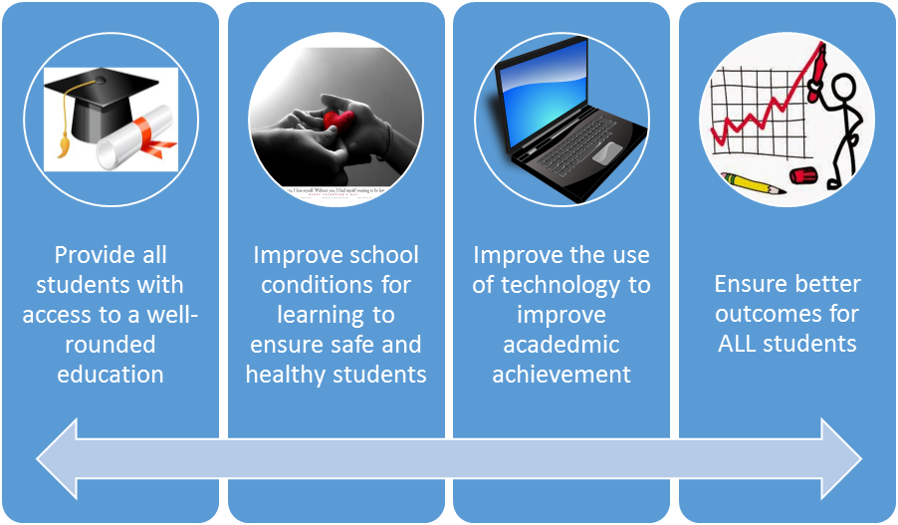
Title IV Part A - Intent
To improve student academic achievement by increasing the capacity of State, local educational agencies, schools, and local community to:

Slide 19
Title IV Requirements
Comprehensive Needs Assessment - An LEA that receives at least $30,000 in Title IV funds must conduct a comprehensive needs assessment. This assessment must focus on the 3 content areas and include timely and meaningful consultation with stakeholders.
Prioritization of Distribution of Funds - LEAs, or a consortium of LEAs, must prioritize the distribution of funds to schools served by the LEA based on specific factors, including schools with the greatest need and the highest numbers of students from low-income families.
Stakeholder Engagement - During the design and development of applications, an LEA or a consortium of LEAs must engage in consultation with stakeholders in the area served by the LEA. This engagement must be ongoing and continuous.
Required Stakeholders - Stakeholders to be consulted must include, but are not limited to parents, teachers, students, principals, school leaders, specialized instructional support personnel, and others with relevant expertise.

Slide 20
Supplemental not Supplant Requirement
An LEA may not use Title IV funds for the cost of activities if the cost of those activities would have otherwise been paid with State or local funds in the absence of Title IV funds. Two presumptions of supplanting are also outlined.
In other words, if you have normally done these activities and paid for them with state or local funds; now you cannot buy them with SSAE funds

Slide 21
LEA (District) Requirements
Not use more than 1% on administrative costs
Consult with all stake holders (DLPAC, CLPAC, etc..)
Must have needs identified in a needs assessment
Must evaluate the activities and their progress
Must be ready to provide the progress of said activities upon request

Slide 22
Plan for Implementation
Well-defined measurable goals with implementation timelines
Clearly outlined roles and responsibilities for people involved
Identified resources required to support said activity
Process to monitor implementation
An outreach strategy to regularly engage stakeholders

Slide 23
Well Rounded Education
A well-rounded education aims to provide students with a comprehensive learning experience that includes academic, creative, and vocational elements. It is vital in nurturing students' holistic development and preparing them for future challenges.

Slide 24
Strategies for Cultivating Well-Rounded Education
Integrated Curriculum - Seamlessly integrating academic subjects with extracurricular activities to offer a holistic educational experience.
Social-Emotional Learning Initiatives - Incorporating programs to promote self-awareness, social connections, and emotional regulation within the curriculum.
Student Engagement - Fostering an environment that encourages active student participation in a wide array of school activities and initiatives.

Slide 25
The Benefits of Well-Rounded Education
Academic Growth - A well-rounded approach leads to improved academic performance by fostering a love for learning and a deeper understanding of diverse subjects.
Social Integration - Students develop strong interpersonal skills, empathy, and teamwork abilities through participation in varied extracurricular activities and collaborative projects.
Emotional Intelligence - It hones emotional intelligence, resilience, self-awareness, and empathy, equipping students to navigate real-world challenges with confidence.
Personal Growth - Encourages holistic growth, nurturing a well-balanced individual with a deep appreciation for the arts, physical well-being, and community involvement.

Slide 26
Examples of Well-Rounded Education Programs
Integrated arts programs that foster creativity and self-expression
Career and technical education (CTE) programs that offer hands-on training in various industries
Comprehensive academic enrichment initiatives that provide opportunities for advanced learning and intellectual growth

Slide 27
Sample Programs for Holistic Student Development
Bullying Prevention
Mental Health Services
Substance Abuse Programs
School Safety Measures
Conflict Resolution
Nutrition and Wellness Initiatives
Sexual Assault Prevention
Emergency Preparedness

Slide 28
The Future Impact of Well – Rounded Education
Life-Long Skills - Prepares students with vital life skills, critical thinking abilities, and a deep appreciation for holistic development
Career Success - Nurtures well-rounded individuals poised for success in diverse career paths and future endeavors
Community Impact - Empowers students to positively impact their communities through social awareness and responsible citizenship

Slide 29
Safe and Healthy Students
This area emphasizes creating a supportive environment for students by addressing their physical, mental, and emotional well-being. It promotes health and safety measures to ensure a conducive learning atmosphere.

Slide 30
Strategies for Promoting Student Safety and Well Being
Mental health programs that provide counseling and support services ​
Safety protocols and emergency response plans ​
Nutritious meal options and wellness programs ​
Inclusive and anti-bullying initiatives

Slide 31
Importance of Safe and Healthy School Environments
Physical Well-being - A safe environment promotes physical health, reducing risks of accidents and injuries.
Mental Health - Healthy environments contribute to lower stress levels and better mental well-being.
Positive Learning Experience - Students thrive in safe and supportive settings, leading to improved academic performance.

Slide 32
Impact of Safe and Healthy School Environments
Academic Performance - Research indicates a significant increase in test scores and graduation rates in safe school environments.
Behavioral Improvement - Safe and healthy environments contribute to reduced disciplinary issues and improved student behavior.

Slide 33
Strategies for Creating Safe and Healthy School Environment
Prevention Programs - Educational initiatives focusing on preventing bullying and enhancing safety awareness.
Wellness Activities - Implementing fitness programs and mental health support sessions to promote overall well-being.

Slide 34
Effective Use of technology
The effective use of technology in education refers to leveraging digital tools to enhance learning outcomes, prepare students for the digital world, and streamline administrative processes for educators and administrators.
Examples:
Using interactive online resources to engage students in active learning
Integrating educational apps and software to reinforce concepts
Providing access to online research databases for independent study
Using video-conferencing tools to connect with experts and classrooms around the world
Implementing learning management systems for efficient assignment submission and grading

Slide 35
Effective Use of Funds
85% of the funds reserved for this section may be used to support a variety of professional development and capacity building
15% of the reserved funds may be used for infrastructure and/or software programs

Slide 36
Benefits of Effective Use in Technology
Enhanced Engagement - Technology in classrooms can motivate and engage students through interactive content, simulations, and multimedia elements, making learning more enjoyable.
Improved Efficiency - Technology streamlines administrative tasks and provides efficient communication channels for teachers, staff, and parents, optimizing school operations.
Enhanced Learning Outcomes - Effective use of technology facilitates personalized learning, adaptive assessments, and immediate feedback, resulting in improved academic performance and skill development.
Global Collaboration - Technology enables students to collaborate with peers and experts worldwide, fostering global awareness, cultural understanding, and diverse perspectives.

Slide 37
Allowable Use of Funds
blended learning strategies
Implement school/district wide approaches to provide personalized professional development to educators
Implement after school activities for the integration of said activities
Help educators learn how to use technology to increase the engagement of English learner students and communication with parents of ELs
Provide rural, remote & underserved areas with resources to take advantage of high-quality digital learning experiences/online
Professional development & learning for STEM

Slide 38
2023-2024 Title IV Funding Distribution for Donna ISD
2023-2024 Entitlement | 718,074
2022-2023 Carryover | 281,966
Indirect Cost | (39,035)
Estimated Grand Total | 961,005
Salaries | 333,799
Advanced Academics | 63,496
Counseling Department | 31,000
Federal Programs Department | 145,120
Police Department | 10,000
Anonymous Alert | 4,709
Vaping Devices Subscription | 15,575
A.R.T.E.S. Program | 65,569
Mariachi Consultant | 20,000
R.E.A.D.Y. Program | 52,000
Summer School | 140,000
Campus Allocations | 79,737
Total Expenditures | 961,005

Slide 39
Q&A
Mr. Guerrero inquired on the mariachi consultant and what the $20,000 is being used for? Mrs. Cano said there was no qualified teacher on campus to teach mariachi and a consultant had to be hired.
Mr. Guerrero asked on the mental health on how the monies are divided among the campuses and if there is data on the sexual and substance abuse cases. If that was enough money for the campuses? Debra Harris answered that the funds in the police department might be funded through a different fund maybe that is why it was low. Donna ISD has other grants in place that cover mental health as well as other adverse situations our students go through. Note: Required trainings cannot be covered by federal programs.
Ms. Anderson asked if the PowerPoint wording was correct if it was STEAM vs STEM under the allowable use of funds slide. Mrs. De Hoyos answered that the wording is correct with STEM.
Mrs. Hinojosa asked if she can have a copy of this PowerPoint. PowerPoint was provided.

Slide 40
Q&A Continued
Mrs. Anderson asked for the projection for next year? How it will affect these grant salaries? Grants will be affected since personnel will need to be picked up by 199, 211, or 164.
Mr. Guerrero asked if the ESSA funds are used for certain kids? If they purchase laptops for kids, do the kids keep them? Ms. Anderson answered the laptops stay on campus. Mrs. Harris answered there was a grant to help buy for 3rd grade laptops. ESSA funds are for all students.
Ms. Anderson asked if blackboard connect was going to be in skyward? Mrs. Harris answered that skyward needed to incorporate that software in.
Mrs. Hinojosa asked why Rivas has an afterschool camp? If Salinas can get that as well since their campus does not have ACE. Rivas does not have a camp, it is after school tutorial.
Mr. Arellano asked if we can have a graphic flow chart on all funds and accounts. You can find Title I and Title II flowchart on the Federal Programs webpage as well as A Guide To Federal Spending that cover Title I, Title II, Title III, and Title IV.

Slide 41
Title 1 Carryover
2022-2023 Carryover​ | 1,370,709​
Indirect Cost​ | (53,504)​
Grand Total​ | 1,317,205
Salaries​ | 375,539
Federal Programs Dept | 201,025
Summer School Program​ | 679,886
Parental Involvement Dept.​ | 60,755​
Total Expenditures​ | 1,317,205

Slide 42
Title II Carryover
2022-2023 Carryover | 797,672
Indirect Cost | (31,136)
Grand Total | 766,536
Federal Programs Dept. | 206,692
Capturing Kids Hearts Consultant/PD | 409,660
Early Childhood Conference | 15,050
Curriculum/Instr. Curr. Writing | 135,134
Total Expenditures | 766,536

Slide 43
Title IV Carryover
2022-2023 Carryover | 281,966
Indirect Cost | (11,006)
Grand Total | 270,960
Advanced Academics | 20,000
Vaping Devices | 108,960
C&I Summer School Supplies | 142,000
Total Expenditures | 270,960
Advanced Academics – Sure Score test prep and supplies
Vaping Devices – as per Mr. Mosqueda the district will not get them
C&I – supplies for math and science classes

Slide 44
Questions/Concerns

